Slide 1
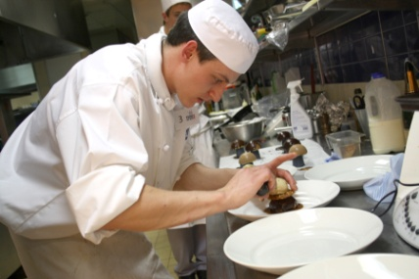
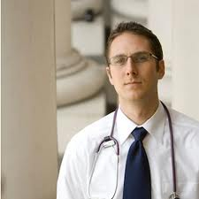
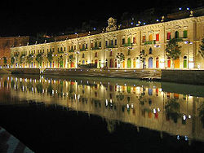
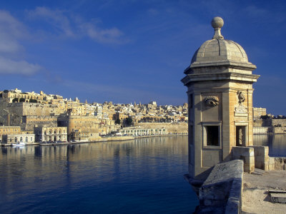
An internship in Malta… More than just an internship!

Slide 2
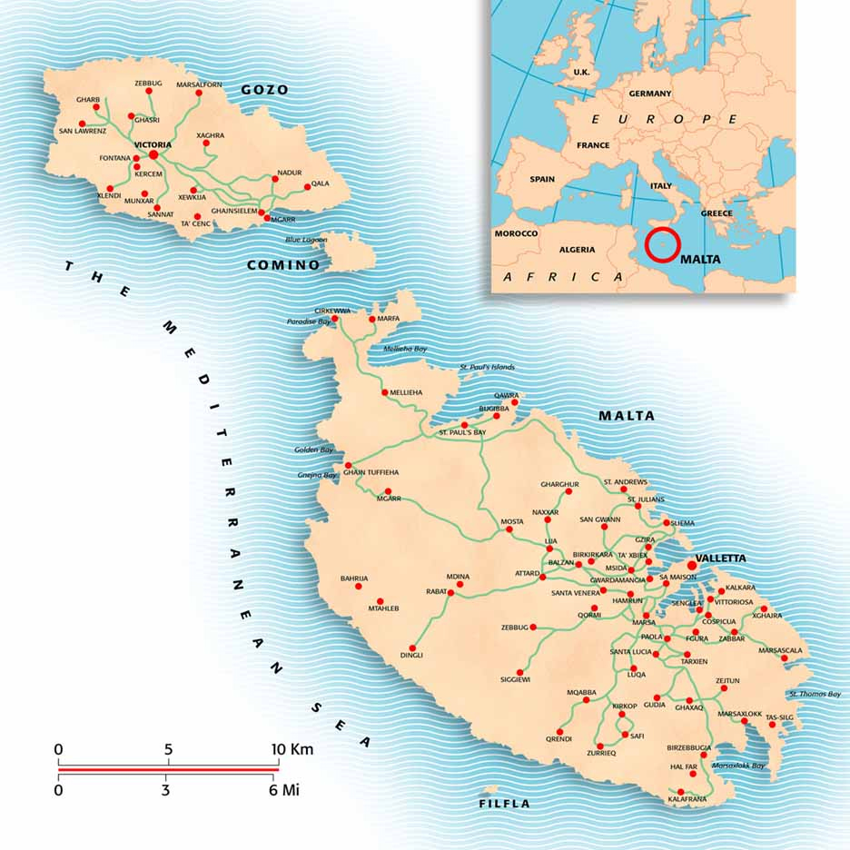
General Overview of Malta
The Maltese Archipelago consists of three islands: Malta, Gozo and Comino
Malta is the largest island and the cultural, commercial and administrative centre.
Gozo is the second largest island and is more rural, characterised by fishing, tourism, crafts and agriculture while Comino is largely uninhabited.
With superbly sunny weather, expansive beaches, a thriving nightlife and 7,000 years of intriguing history, there is a great deal to see and do.
Its population in 2010 was of 416 333 people
In 1974 Malta was proclaimed as a Republic within the Commonwealth
Malta became a Member of the European Union on 1st May 2004

Slide 3
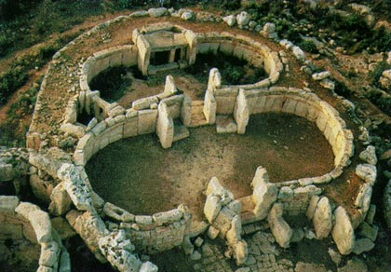
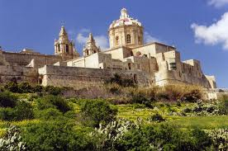
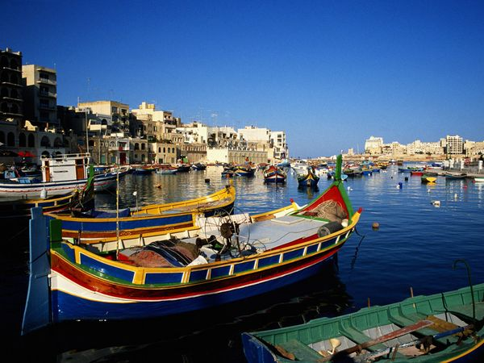
One of the world's smallest countries.
Its capital city is Valletta.
The country has two official languages – Maltese and English – with Maltese being considered the national language.
Throughout history, Malta's location has given it great strategic importance, and a sequence of powers including the Phoenicians, Greeks, Romans, Arabs, Normans, Sicilians, Knights of the Order of St. John, French and British all ruled the islands.
Maltese currency since 2008 is the Euro.
Catholicism is the official religion in Malta.
Malta is internationally renowned as a tourist resort, with numerous recreational areas and 1000s of historical monuments, including nine UNESCO World Heritage Sites, most prominently the Megalithic Temples which are some of the oldest free-standing structures in the world
Notes:
For e

Slide 4
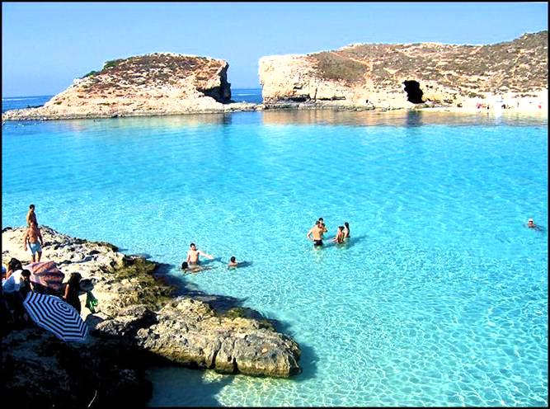
Weather
A very sunny climate with a daily average of five to six hours sunshine in mid-winter to around 12 hours in summer.
Winters are mild, with the occasional very short chilly period. Average winter temperature is 15 °c. With the coldest few nights reaching 8 to 5°c at night.
Summers are hot, dry and very sunny. Average summer temperature is on average 35 °c which can also escalate even higher.
.
The last time it snowed in Malta was in 1895!

Slide 5
Tourism in Malta
Tourism in Malta is an important sector of the country's economy, contributing to about 15 % of the nation's GDP.
Last year (2012), Malta had an all time record for tourism in Malta (1.44 milllion tourists).
The industry continues to be resilient and the first two quarters of this year have already moreover proved to be another record year with a 10% increase on the figures in 2012.
Tourism in Malta is starting to carve its niche in the world of travel.

Slide 6
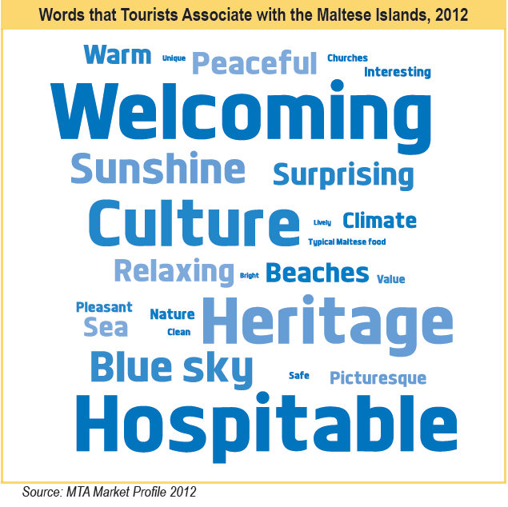

Slide 7
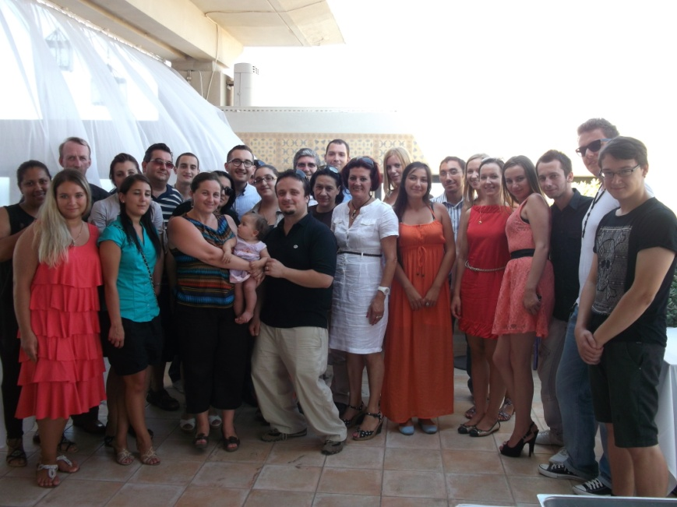
Paragon Europe
Paragon Limited strives to be a one-stop shop for any client, local and foreign alike, through its capability to operate as a consultant, promoter, project manager or active participant in EU-funded trans-national projects.
Following Malta’s accession in the European Union in May 2004, Paragon Limited has been successful in sourcing funds for EU projects submitted under a number of programmes, such as The Sixth Framework Programme for Research and Development (FP6), Leonardo da Vinci, ERASMUS, INTERREG III, eContentplus and EuroMed.

Slide 8
Internship Programme in Malta
Paragon Europe manages successful INTERNSHIP PROGRAMMES Leonardo da Vinci and ERASMUS mostly acting as a receiving company.
Through our experience of 8 years, today we are collaborating with more than 1500 partner companies in all sectors in Malta.
We offer a placement starting from 3 weeks with practical work experience in line with your chosen area and shared accommodation in fully equipped apartments in close proximity to work placement, shopping, clinic and entertainment outlets.
Paragon has a dedicated and experienced support team that takes care of all the administration and logistics with continuous monitoring of the students during their work placement
Students will also benefit from learning English whilst doing their valuable work experience.

Slide 9
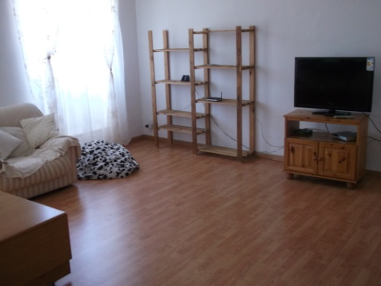
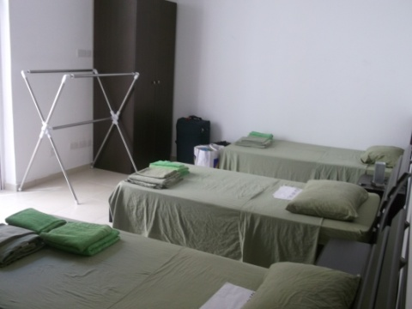
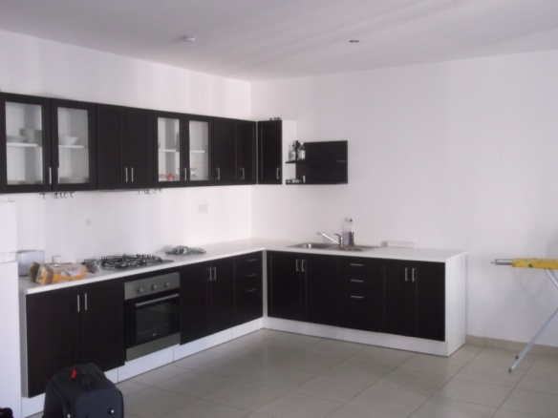
Shared accommodation
Equipped kitchen and comfortable living/dining area
2 sets of bed linen and towels per person.
Balconies and terrace
Fans, TV, free WI-FI and telephone line (to be used with pre-paid cards)
Washing Machine
Iron and Ironing Board
Free maintenance and maid services
No fixed check-in/check-out time
Close proximity to work placement, shopping areas, clinics and entertainment outlets

Slide 10
Placement Sectors
Project Management, Business, Research, PR & Marketing, Communications, Finance and Economics, Insurance, Administration, Pedagogy, Health, Pharmacy, Social Work, Care and Beauty, Dentistry, Veterinary, Heritage, Design, ICT, Tourism, Hospitality, Environmental Management, Media, Logistics, Aviation, Security, Event management, Law, Engineering, Architecture, Entertainment and Animation, Retail, Real Estate, laboratory Analysts and Technicians, Sports, Automotive, Carpentry, Plumbing, Electricians, Draftsmen, Landscaping, Photography and much more…

Slide 11
Testimonials
INTERN
“With regards to the student with us, she is doing fine and learning a lot, not just accounting, but also those -what I call - common sense facts of life, that will help her in any job that she will do in future.
As you well know, Larissa is with us until early January 2014. I would like to ask you whether you have any other suitable candidates to do an internship in our accounts department for a long stretch of time.”
Look forward to hear from you soon,
Joe Zahra,
Accountant Alpine Travel & Tourism.
“I found this place as a unique possibility to spend your summer time both with pleasure and useful experience during my stay. I gained important professional skills at my work placement as well as unforgettable memories and new friends. But remember, all depends on how active you are.”
Pavlo Skakun
Jagiellonian University
Poland
HOST COMPANY

Slide 12
Thank you for your attention
E-mail me today to avoid any disappointment
kimberly.azzopardi@paragoneurope.eu

